Slide 1
PROJECTILE MOTION When an object is thrown vertically upward, it goes up with its velocity decreasing until the velocity becomes zero at the maximum height. It returns to the exact point of throw if wind effects do not affect it, and in exactly the same time taken to reach the maximum height.

Slide 2
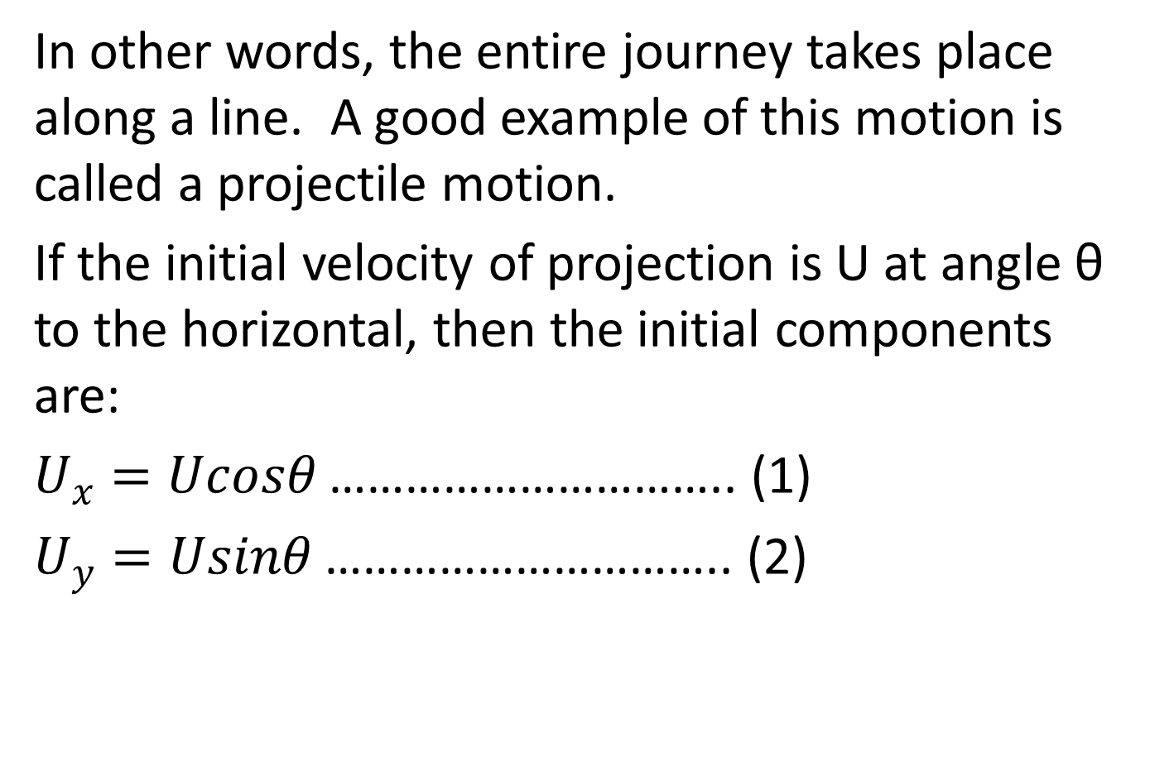
In other words, the entire journey takes place along a line. A good example of this motion is called a projectile motion.
If the initial velocity of projection is U at angle θ to the horizontal, then the initial components are:
$U_{x}=Ucosθ$ ………………………….. (1)
$U_{y}=Usinθ$ ………………………….. (2)

Slide 3
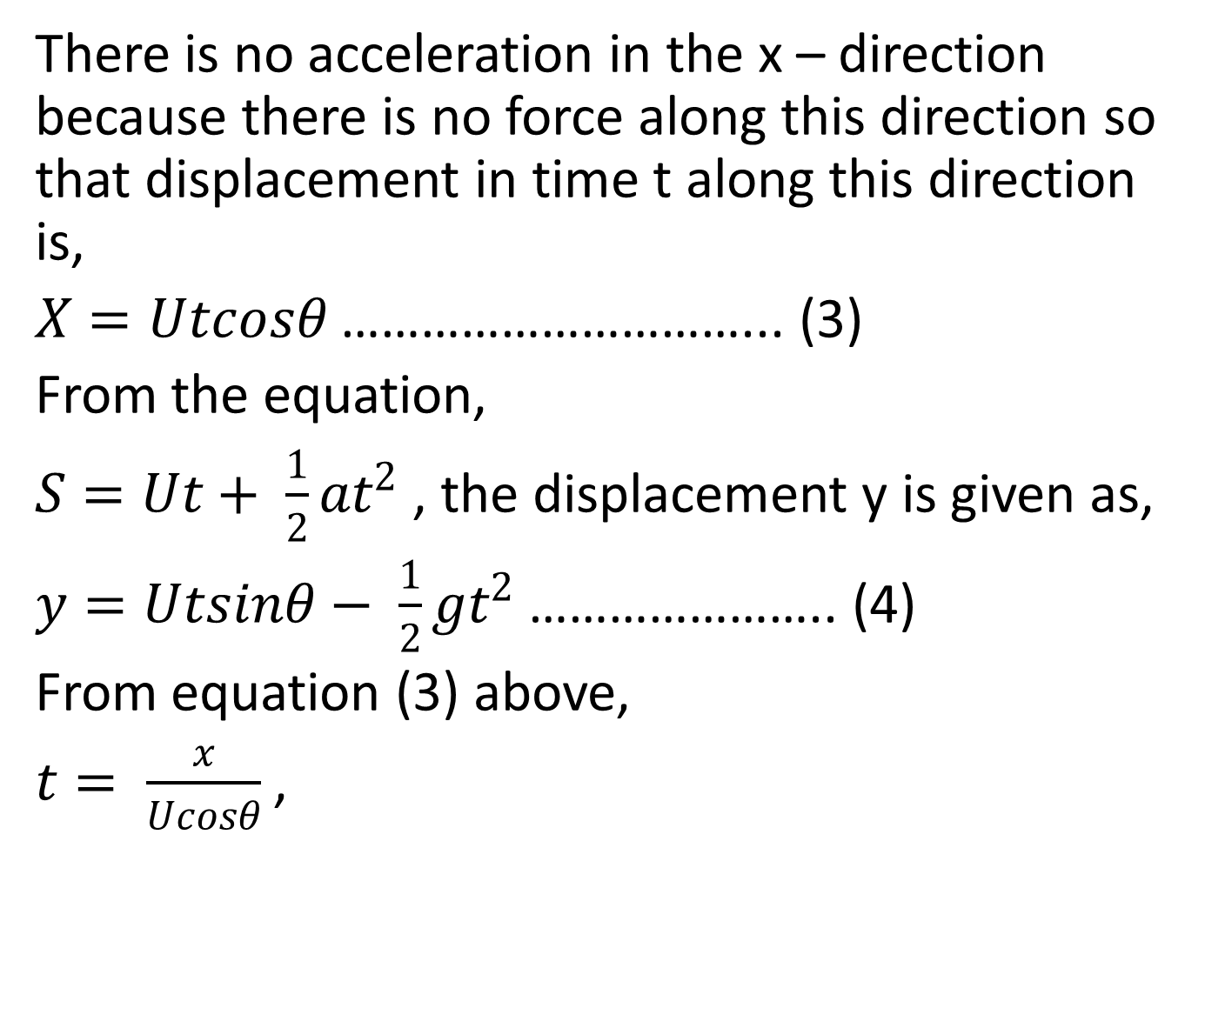
There is no acceleration in the x – direction because there is no force along this direction so that displacement in time t along this direction is,
$X=Utcosθ$ …………………………... (3)
From the equation,
$S=Ut+ \frac{1}{2}at^{2}$ , the displacement y is given as,
$y=Utsinθ− \frac{1}{2}gt^{2}$ ………………….. (4)
From equation (3) above,
$t= \frac{x}{Ucosθ}$ ,

Slide 4
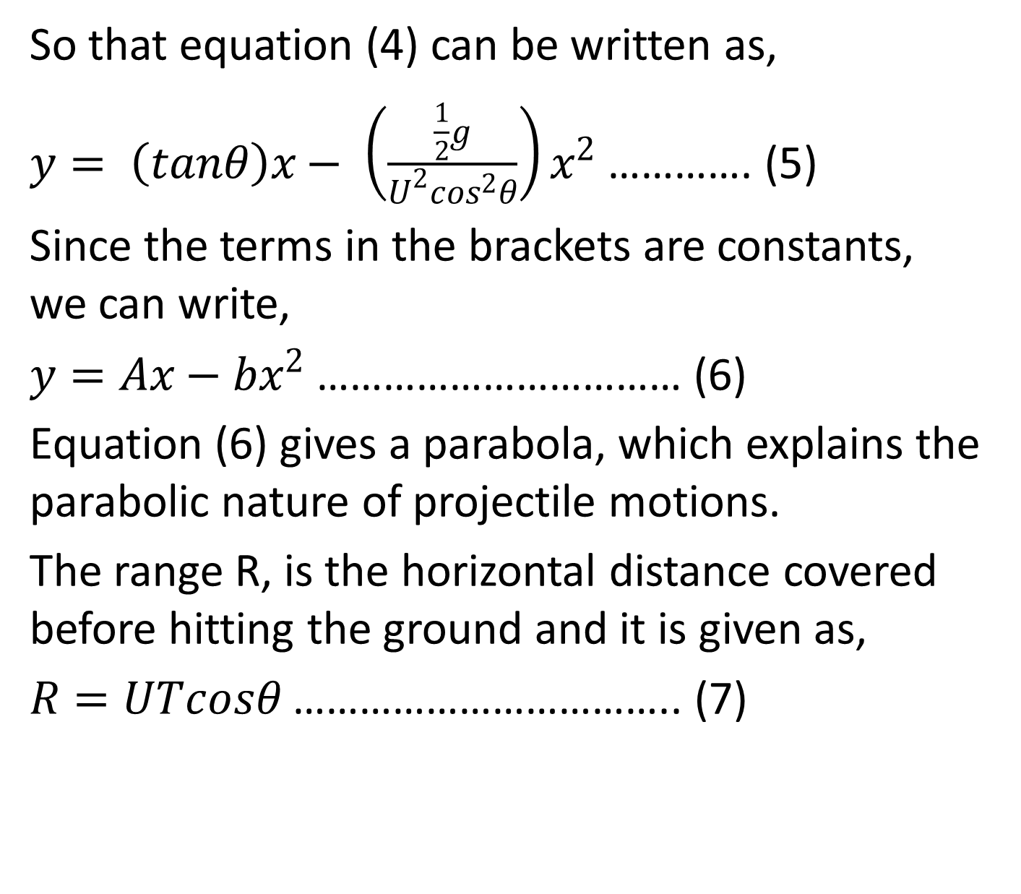
So that equation (4) can be written as,
$y= \left(tanθ\right)x− \left(\frac{\frac{1}{2}g}{U^{2}\cos^{2}θ}\right)x^{2}$ …………. (5)
Since the terms in the brackets are constants, we can write,
$y=Ax−bx^{2}$ …………………………… (6)
Equation (6) gives a parabola, which explains the parabolic nature of projectile motions.
The range R, is the horizontal distance covered before hitting the ground and it is given as,
$R=UTcosθ$ …………………………….. (7)

Slide 5
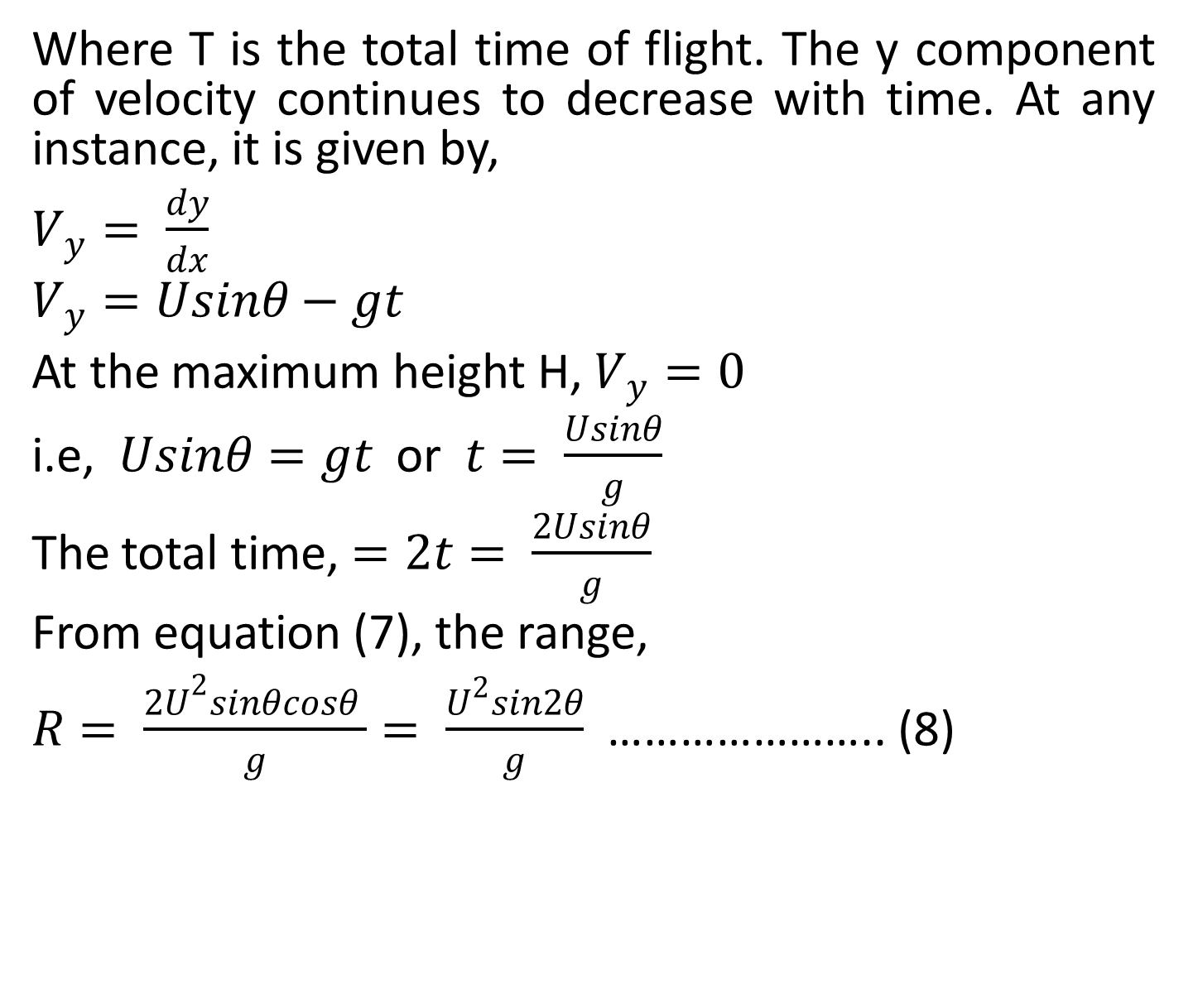
Where T is the total time of flight. The y component of velocity continues to decrease with time. At any instance, it is given by,
$V_{y}= \frac{dy}{dx}$
$$V_{y}=Usinθ−gt$$
At the maximum height H, $V_{y}=0$
i.e, $Usinθ=gt$ or $t= \frac{Usinθ}{g}$
The total time, $=2t= \frac{2Usinθ}{g}$
From equation (7), the range,
$R= \frac{2U^{\begin{aligned}2 \\ \end{aligned}}sinθcosθ }{g}= \frac{U^{2}sin2θ}{g}$ ………………….. (8)

Slide 6
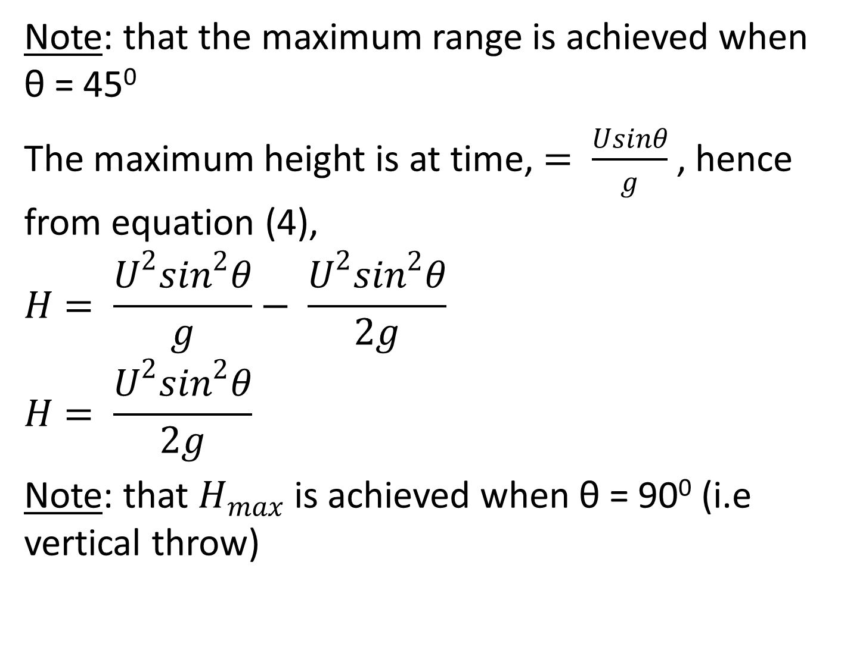
Note: that the maximum range is achieved when θ = 45⁰
The maximum height is at time, $= \frac{Usinθ}{g}$ , hence from equation (4),
$$H= \frac{U^{2}\sin^{2}θ}{g}− \frac{U^{2}\sin^{2}θ}{2g}$$
$$H= \frac{U^{2}\sin^{2}θ}{2g}$$
Note: that $H_{max}$ is achieved when θ = 90⁰ (i.e vertical throw)

Slide 7
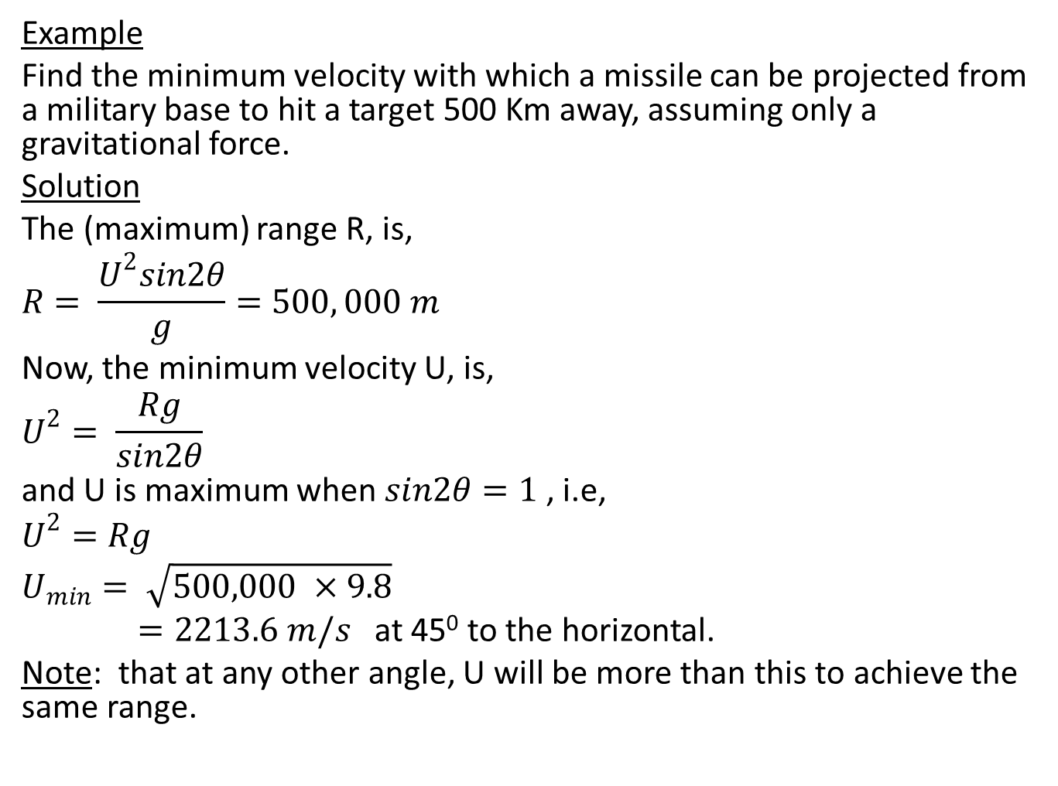
Example
Find the minimum velocity with which a missile can be projected from a military base to hit a target 500 Km away, assuming only a gravitational force.
Solution
The (maximum) range R, is,
$$R= \frac{U^{2}sin2θ}{g}=500, 000 m$$
Now, the minimum velocity U, is,
$$U^{2}= \frac{Rg}{sin2θ}$$
and U is maximum when $sin2θ=1$ , i.e,
$$U^{2}=Rg$$
$$U_{min}= \sqrt{500,000 ×9.8}$$
$=2213.6 m/s$ at 45⁰ to the horizontal.
Note: that at any other angle, U will be more than this to achieve the same range.

Slide 8
TUTORIAL
(1). A bullet is fired vertically upward with an initial velocity of 98 m/s from the top of a building 100 m high. Find,
(a). the maximum height reached above the ground
(b). the total time before reaching the ground
(c). the velocity on landing
(2). A table tennis ball is dropped onto the floor from a height 4 m and it rebounds to a height of 3 m. If the time of contact with the floor is 0.01s, what is the magnitude and direction of the acceleration during the contact?

